Slide 1
Hashtables
David Kauchak CS 140 – Spring 2024

Slide 2
Admin
Assignment 5 and 6 back soon
Assignment 7 our and due on Sunday
Normal group session schedule this week

Slide 3
Hashtables
What do you know/remember?

Slide 4
Hashtables
Constant time insertion and search (and deletion in some cases) for a large space of keys
Applications
Does x belong to S?
I’ve found them very useful (go by many names, maps, dictionaries, …)
compilers
databases
search engines
storing and retrieving non-sequential data
save memory over an array

Slide 5
Hashtables
Constant time insertion and search (and deletion in some cases) for a large space of keys
For this class, we’ll just think of them as a collection of keys
For many applications/implementations, there is a value associated with the key, i.e., key/value pair (though lookup is still exclusively based on the key)

Slide 6
Key/data pair
The key is a numeric representation of a relevant portion of the data
For example:
data
key
integer
number

Slide 7
Key/data pair
The key is a numeric representation of a relevant portion of the data
For example:
key?
data
string
number

Slide 8
Key/data pair
The key is a numeric representation of a relevant portion of the data
For example:
data
key
ascii code
string
number

Slide 9
Key/data pair
The key is a numeric representation of a relevant portion of the data
For example:
key?
data
account information
number

Slide 10
Key/data pair
The key is a numeric representation of a relevant portion of the data
For example:
ascii code of first and last name
key
data
account information
number

Slide 11
Why not just arrays aka direct-address tables?
array must be as large as the universe of keys
universe of keys - U
Array

Slide 12
Why not just arrays?
array must be as large as the universe of keys
universe of keys - U
space of actual keys is often much smaller than the actual keys
actual keys, n
Array

Slide 13
Why not arrays?
Think of indexing all last names < 10 characters
Census listing of all last names http://www.census.gov/genealogy/names/dist.all.last
88,799 last names
What is the size of our space of keys?
26¹⁰ = a big number
Not feasible!
Even if it were, not space efficient

Slide 14
The load of a table/hashtable
m = number of possible entries in the table
n = number of keys stored in the table
α = n/m is the load factor of the hashtable
What is the load factor of the last example?
α = 88,799 / 26¹⁰ would be the load factor of last names using direct-addressing
The smaller α, the more wasteful the table
The load also helps us talk about run time

Slide 15
Hash function, h
A hash function is a function that maps the universe of keys to the slots in the hashtable
universe of keys - U
hash function, h: U ➔m
m << |U|

Slide 16
Hash function, h
A hash function is a function that maps the universe of keys to the slots in the hashtable
universe of keys - U
hash function, h: U ➔m
m << |U|

Slide 17
Hash function, h
A hash function is a function that maps the universe of keys to the slots in the hashtable
universe of keys - U
hash function, h: U ➔m
m << |U|

Slide 18
Hash function, h
What can happen if m < |U|?
universe of keys - U
hash function, h: U ➔m
m << |U|

Slide 19
Collisions
If m < |U|, then two keys can map to the same position in the hashtable (pidgeonhole principle)
universe of keys - U
hash function, h
m << |U|

Slide 20
Collisions
A collision occurs when h(x) = h(y), but x ≠ y
A good hash function will minimize the number of collisions
Because the number of hashtable entries is less than the possible keys (i.e. m < |U|) collisions are inevitable!
Collision resolution techniques?

Slide 21
Collision resolution by chaining
Hashtable consists of an array of linked lists
When a collision occurs, the element is added to linked list at that location
If two entries x ≠ y have the same hash value h(x) = h(y), then T(h(x)) will contain a linked list with both values

Slide 22
Insertion
ChainedInsert(x):
entry = h(x)
insert x at the head of T[entry]
ChainedHashInsert( )

Slide 23
Insertion
ChainedInsert(x):
entry = h(x)
insert x at the head of T[entry]
h( )
hash function is a mapping from the key to some value < m

Slide 24
Insertion
ChainedInsert(x):
entry = h(x)
insert x at the head of T[entry]
h( )

Slide 25
Deletion
ChainedDelete(x):
entry = h(x)
delete x at the list at T[entry]
What does that involve?

Slide 26
Deletion
ChainedDelete(x):
entry = h(x)
delete x at the list at T[entry]
Search though the list!

Slide 27
Deletion
ChainedDelete(x):
entry = h(x)
delete x at the list at T[entry]
ChainedHashDelete( )

Slide 28
Deletion
ChainedDelete(x):
entry = h(x)
delete x at the list at T[entry]
h( )

Slide 29
Deletion
ChainedDelete(x):
entry = h(x)
delete x at the list at T[entry]

Slide 30
Deletion
ChainedDelete(x):
entry = h(x)
delete x at the list at T[entry]

Slide 31
Deletion
ChainedDelete(x):
entry = h(x)
delete x at the list at T[entry]

Slide 32
Search
ChainedSearch(x):
entry = h(x)
search for x in list T[entry]
ChainedHashSearch( )

Slide 33
Search
ChainedSearch(x):
entry = h(x)
search for x in list T[entry]
h( )

Slide 34
Search
ChainedSearch(x):
entry = h(x)
search for x in list T[entry]
ChainedHashSearch( )

Slide 35
Search
ChainedSearch(x):
entry = h(x)
search for x in list T[entry]
ChainedHashSearch( )

Slide 36
Search
ChainedSearch(x):
entry = h(x)
search for x in list T[entry]
ChainedHashSearch( )

Slide 37
Running time
ChainedInsert(x):
entry = h(x)
insert x at the head of T[entry]
Θ(1)
ChainedDelete(x):
entry = h(x)
delete x at the list at T[entry]
O(length of the chain)
ChainedSearch(x):
entry = h(x)
search for x in list T[entry]
O(length of the chain)

Slide 38
Length of the chain
Worst case?

Slide 39
Length of the chain
Worst case?
All elements hash to the same location
h(k) = 4
n
…

Slide 40
Length of the chain
Average case:
Depends on how well the hash function distributes the keys
What is the best we could hope for a hash function?
simple uniform hashing: an element is equally likely to end up in any of the m slots
Under simple uniform hashing what is the average length of a chain in the table?
n keys over m slots = n / m = α

Slide 41
Average chain length
If you roll a fair m sided die n times, how many times are we likely to see a given value?
For example, 10 sided die:
1 time
1/10
100 times
100/10 = 10

Slide 42
Search average running time
Two cases:
Key is not in the table
must search all entries
Θ(1 + α)
Key is in the table
on average search half of the entries
O(1 + α)

Slide 43
Hash functions
What makes a good hash function?
Approximates the assumption of simple uniform hashing
Deterministic – h(x) should always return the same value
Low cost – if it is expensive to calculate the hash value (e.g. log n) then we don’t gain anything by using a table
Challenge: we don’t generally know the distribution of the keys
Frequently data tend to be clustered (e.g. similar strings, run-times, SSNs). A good hash function should spread these out across the table

Slide 44
Hash functions
What are some hash functions you’ve heard of before?

Slide 45
Division method
h(k) = k mod m
m k h(k)
11 25
11 1
11 17
13 133
13 7
13 25

Slide 46
Division method
h(k) = k mod m
m k h(k)
11 25
3
11 1
1
11 17
6
13 133
3
13 7
7
13 25
12

Slide 47
Division method
Don’t use a power of two. Why?
m k bin(k) h(k)
25 11001
8 1 00001
8 17 10001

Slide 48
Division method
Don’t use a power of two. Why?
if h(k) = k mod 2^{p}, the hash function is just the lower p bits of the value
m k bin(k) h(k)
25 11001 1
8 1 00001 1
8 17 10001 1

Slide 49
Division method
Good rule of thumb for m is a prime number not too close to a power of 2
Pros:
quick to calculate
easy to understand
Cons:
keys close to each other will end up close in the hashtable

Slide 50
Multiplication method
Multiply the key by a constant 0 < A < 1 and extract the fractional part of kA, then scale by m to get the index
extracts the fractional portion of kA

Slide 51
Multiplication method
Common choice is for m as a power of 2 and
Why a power of 2?
Book has other heuristics

Slide 52
Multiplication method
Common choice is for m as a power of 2 and
Book has other heuristics

Slide 53
Multiplication method
m k A
8 15 0.618
8 23 0.618
8 100 0.618
kA h(k)

Slide 54
Multiplication method
m k A
8 15 0.618
8 23 0.618
8 100 0.618
kA h(k)
9.27
floor(0.27*8) = 2
14.214
floor(0.214*8) = 1
61.8
floor(0.8*8) = 6

Slide 55
Other hash functions
http://en.wikipedia.org/wiki/List_of_hash_functions
cyclic redundancy checks (i.e. disks, cds, dvds)
Checksums (i.e. networking, file transfers)
Cryptographic (i.e. MD5, SHA)

Slide 56
Open addressing
Keeping around an array of linked lists can be inefficient and a hassle
Like to keep the hashtable as just an array of elements (no pointers)
How do we deal with collisions?
compute another slot in the hashtable to examine

Slide 57
Hash functions with open addressing
Hash function must define a probe sequence which is the list of slots to examine when searching or inserting
The hash function takes an additional parameter i which is the number of collisions that have already occurred
The probe sequence must be a permutation of every hashtable entry. Why?
{ h(k,0), h(k,1), h(k,2), …, h(k, m-1) } is a permutation of { 0, 1, 2, 3, …, m-1 }
Notes:
If we didn’t do this, we wouldn’t visit all of the entries in the table!

Slide 58
Hash functions with open addressing
Hash function must define a probe sequence which is the list of slots to examine when searching or inserting
The hash function takes an additional parameter i which is the number of collisions that have already occurred
The probe sequence must be a permutation of every hashtable entry. Why?
If not, we wouldn’t explore all the possible location in the table!
Notes:
If we didn’t do this, we wouldn’t visit all of the entries in the table!

Slide 59
Probe sequence
h(k, 0)

Slide 60
Probe sequence
h(k, 1)

Slide 61
Probe sequence
h(k, 2)

Slide 62
Probe sequence
h(k, 3)

Slide 63
Probe sequence
h(k, …)
must visit all locations
…

Slide 64
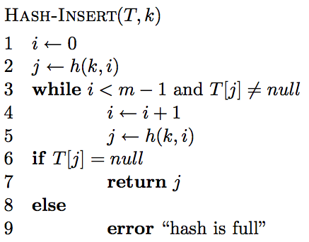
Open addressing: Insert

Slide 65
Open addressing: Insert
get the first hashtable entry to look in

Slide 66
Open addressing: Insert
follow the probe sequence until we find an open entry

Slide 67
Open addressing: Insert
return the open entry

Slide 68
Open addressing: Insert
hashtable can fill up

Slide 69
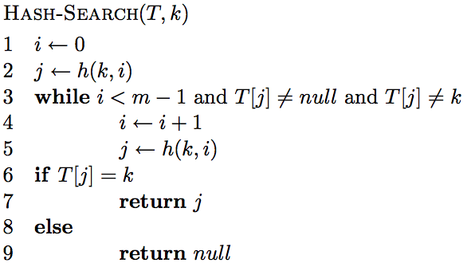
Open addressing: search

Slide 70
Open addressing: search

Slide 71
Open addressing: search
“breaks” the probe sequence

Slide 72
Delete
k
h(k, 0)
h(k, 2)
h(k, 1)

Slide 73
Delete
Can we just delete this node?
k
h(k, 0)
h(k, 2)
h(k, 1)

Slide 74
Delete
Can we just delete this node?
k
h(k, 0)
h(k, 2)

Slide 75
Delete
Can we just delete this node?
No! Now if we search for k we’ll mistakenly think it’s not there!
k
h(k, 0)
h(k, 2)
h(k, 1)

Slide 76
Open addressing: delete
Two options:
mark node as “deleted” (rather than null)
modify search procedure to continue looking if a “deleted” node is seen
modify insert procedure to fill in “deleted” entries
increases search times
if a lot of deleting will happen, use chaining

Slide 77
Probing schemes
Linear probing – if a collision occurs, go to the next slot
h(k,i) = (h(k) + i) mod m
Does it meet our requirement that it visits every slot?
for example, m = 7 and h(k) = 4
h(k,0) = 4
h(k,1) = 5
h(k,2) = 6
h(k,3) = 0
h(k,3) = 1

Slide 78
Linear probing: search
h( , 0)

Slide 79
Linear probing: search
h( , 1)

Slide 80
Linear probing: search
h( , 2)

Slide 81
Linear probing: search
h( , 3)

Slide 82
Linear probing: search
h( , 3)

Slide 83
Linear probing
Problem:
primary clustering – long runs of occupied slots tend to build up and these tend to grow
any value here results in an increase in the cluster
become more and more probable for a value to end up in that range

Slide 84
Quadratic probing
h(k,i) = (h(k) + c₁i + c₂i²) mod m
Rather than a linear sequence, we probe based on a quadratic function
Problems:
must pick constants and m so that we have a proper probe sequence
if h(x) = h(y), then h(x,i) = h(y,i) for all i
secondary clustering

Slide 85
Double hashing
Probe sequence is determined by a second hash function
h(k,i) = (h₁(k) + i(h₂(k))) mod m
Problem:
h₂(k) must visit all possible positions in the table

Slide 86
Running time of insert and search for open addressing
Depends on the hash function/probe sequence
Worst case?
O(n) – probe sequence visits every full entry first before finding an empty

Slide 87
Running time of insert and search for open addressing
Average case?
We have to make at least one probe

Slide 88
Running time of insert and search for open addressing
Average case?
What is the probability that the first probe will not be successful (assume uniform hashing function)?
α

Slide 89
Running time of insert and search for open addressing
Average case?
What is the probability that the first two probed slots will not be successful?
~α²
why ‘~’?

Slide 90
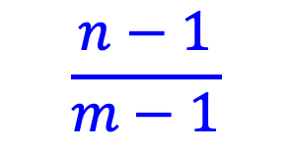
Running time of insert and search for open addressing
Average case?
What is the probability that the first two probed slots will not be successful
~α²
$$\frac{n−1}{m−1}$$
Technically, second probe is:
Notes:
For largish, n and m, this is close to alpha

Slide 91
Running time of insert and search for open addressing
Average case?
What is the probability that the first three probed slots will not be successful?
~α³

Slide 92
Running time of insert and search for open addressing
Average case: expected number of probes
sum of the probability of making 1 probe, 2 probes, 3 probes, …

Slide 93
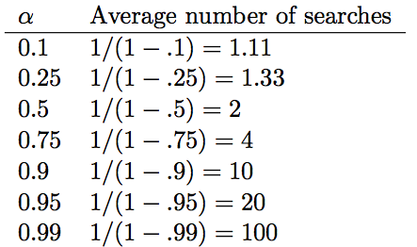
Average number of probes

Slide 94
How big should a hashtable be?
A good rule of thumb is the hashtable should be around half full
What happens when the hashtable gets full?
Copy: Create a new table and copy the values over
results in one expensive insert
simple to implement
Amortized copy: When a certain ratio is hit, grow the table, but copy the entries over a few at a time with every insert
no single insert is expensive and can guarantee per insert performance
more complicated to implement

Slide 95
Handouts/exercises

Slide 96
Questions
Why can’t we just use an array?
What is a hash function? How does it differ from the hash_code method in Java?
What are the two ways we deal with collisions?
Why is it important that the probe sequence visits every spot in the hashtable?

Slide 97
Questions
What are three potential probing mechanisms?
If we insert random data into a hashtable, what is the worst case running time for searching for an item?
If an open-addressed hashtable is half full, on average, how many entries would we expect to search before finding an open one? 75% full?
If we plan to do a lot of deleting, what type of hashtable should we use?

Slide 98
Questions
What is the largest α can be for a hashtable with chaining? Open-addressed?

Slide 99
Fill in the table for division method
h(k) = k mod m
m k h(k)
11 25
11 1
11 17
13 133
13 7
13 25

Slide 100
Fill in the table for multiplication method
m k A
8 15 0.618
8 23 0.618
8 100 0.618
kA h(k)

